Slide 1
Lecture 17 Dynamic set partitions and the union-find algorithm
EECS-214

Slide 2
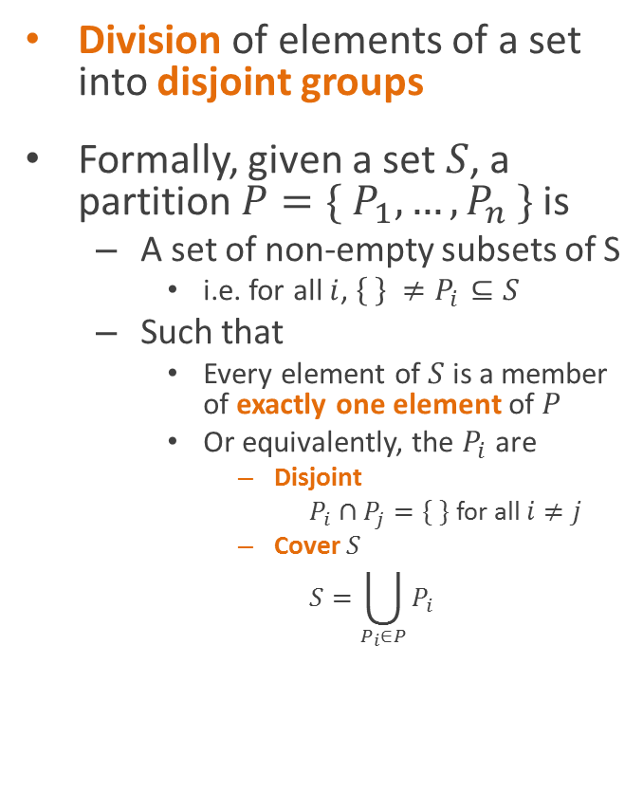
Set partitions
Division of elements of a set into disjoint groups
Formally, given a set $S$, a partition $P=\{ P_{1},…, P_{n} \}$ is
A set of non-empty subsets of S
i.e. for all $i$, $\left\{ \right\} ≠P_{i}⊆S$
Such that
Every element of $S$ is a member of exactly one element of $P$
Or equivalently, the $P_{i}$ are
Disjoint
$P_{i}∩P_{j}=\{ \}$ for all $i≠j$
Cover $S$
$$S=\bigcup_{P_{i}∈P}{P_{i}}$$

Slide 3
Set partitions
Division of elements of a set into disjoint groups
Formally, given a set $S$, a partition $P=\{ P_{1},…, P_{n} \}$ is
A set of non-empty subsets of S
i.e. for all $i$, $\left\{ \right\} ≠P_{i}⊆S$
Such that
Every element of $S$ is a member of exactly one element of $P$
Or equivalently, the $P_{i}$ are
Disjoint
$P_{i}∩P_{j}=\{ \}$ for all $i≠j$
Cover $S$
$$S=\bigcup_{P_{i}∈P}{P_{i}}$$

Slide 4
Set partitions
Division of elements of a set into disjoint groups
Formally, given a set $S$, a partition $P=\{ P_{1},…, P_{n} \}$ is
A set of non-empty subsets of S
i.e. for all $i$, $\left\{ \right\} ≠P_{i}⊆S$
Such that
Every element of $S$ is a member of exactly one element of $P$
Or equivalently, the $P_{i}$ are
Disjoint
$P_{i}∩P_{j}=\{ \}$ for all $i≠j$
Cover $S$
$$S=\bigcup_{P_{i}∈P}{P_{i}}$$

Slide 5
Set partitions
Division of elements of a set into disjoint groups
Formally, given a set $S$, a partition $P=\{ P_{1},…, P_{n} \}$ is
A set of non-empty subsets of S
i.e. for all $i$, $\left\{ \right\} ≠P_{i}⊆S$
Such that
Every element of $S$ is a member of exactly one element of $P$
Or equivalently, the $P_{i}$ are
Disjoint
$P_{i}∩P_{j}=\{ \}$ for all $i≠j$
Cover $S$
$$S=\bigcup_{P_{i}∈P}{P_{i}}$$

Slide 6

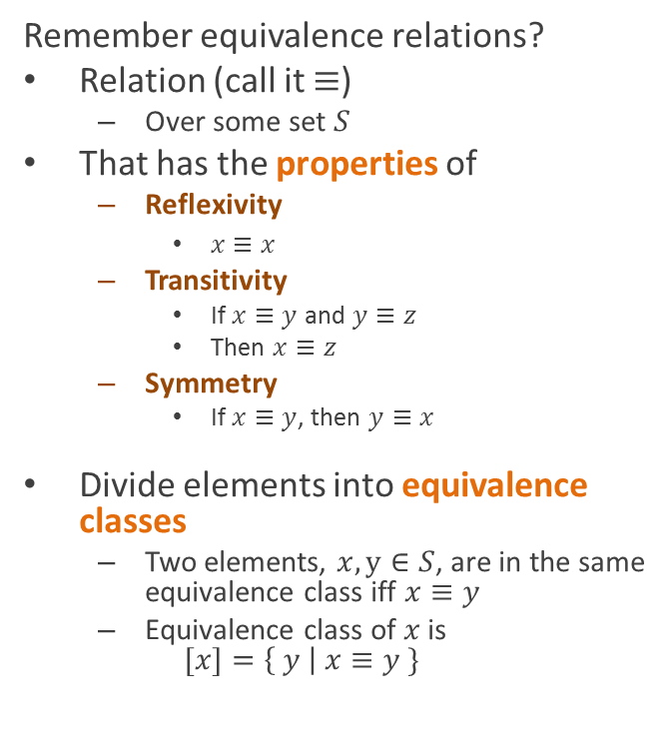
Partitions and equivalence relations
Remember equivalence relations?
Relation (call it $≡$)
Over some set $S$
That has the properties of
Reflexivity
$x≡x$
Transitivity
If $x≡y$ and $y≡z$
Then $x≡z$
Symmetry
If $x≡y$, then $y≡x$
Divide elements into equivalence classes
Two elements, $x, y∈S$, are in the same equivalence class iff $x≡y$
Equivalence class of $x$ is $[x]=\left\{ y \right| x≡y \}$
Partitions and equivalence relations are interchangeable ideas
Equivalence classes form a partition of $S$
Given a partition, we can construct an equivalence relation from it
$a≡b$ iff $a$ and $b$ are in the same set within the partition

Slide 7
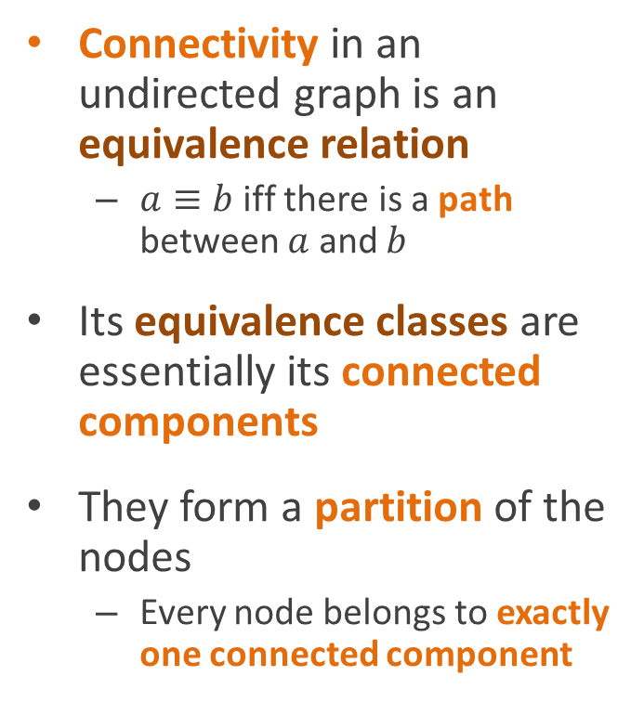
Connected components
Connectivity in an undirected graph is an equivalence relation
$a≡b$ iff there is a path between $a$ and $b$
Its equivalence classes are essentially its connected components
They form a partition of the nodes
Every node belongs to exactly one connected component

Slide 8
Connected components
How do we compute the partition?

Slide 9
Connected component analysis using depth-first search
LabelConnectedComponents()
component = 0
for each node in graph if node not visited LCCVisit(node, component) component++
LCCVisit(node, c) mark node visited node.component = c
for each unvisited neighbor, n, of node
LCCVisit(n, c)
1
4
2
3
8
9
11
5
12
6
7

Slide 10
Connected component analysis using depth-first search
LabelConnectedComponents()
component = 0
for each node in graph if node not visited LCCVisit(node, component) component++
LCCVisit(node, c) mark node visited node.component = c
for each unvisited neighbor, n, of node
LCCVisit(n, c)
1
4
2
3
8
9
11
5
12
6
7

Slide 11
Connected component analysis using depth-first search
LabelConnectedComponents()
component = 0
for each node in graph if node not visited LCCVisit(node, component) component++
LCCVisit(node, c) mark node visited node.component = c
for each unvisited neighbor, n, of node
LCCVisit(n, c)
1
4
2
3
8
9
11
5
12
6
7

Slide 12
Connected component analysis using depth-first search
0
LabelConnectedComponents()
component = 0
for each node in graph if node not visited LCCVisit(node, component) component++
LCCVisit(node, c) mark node visited node.component = c
for each unvisited neighbor, n, of node
LCCVisit(n, c)
1
4
2
3
8
9
11
5
12
6
7

Slide 13
Connected component analysis using depth-first search
0
LabelConnectedComponents()
component = 0
for each node in graph if node not visited LCCVisit(node, component) component++
LCCVisit(node, c) mark node visited node.component = c
for each unvisited neighbor, n, of node
LCCVisit(n, c)
1
4
2
3
8
9
11
5
12
6
7

Slide 14
Connected component analysis using depth-first search
0
LabelConnectedComponents()
component = 0
for each node in graph if node not visited LCCVisit(node, component) component++
LCCVisit(node, c) mark node visited node.component = c
for each unvisited neighbor, n, of node
LCCVisit(n, c)
1
4
0
2
3
8
9
11
5
12
6
7

Slide 15
Connected component analysis using depth-first search
0
LabelConnectedComponents()
component = 0
for each node in graph if node not visited LCCVisit(node, component) component++
LCCVisit(node, c) mark node visited node.component = c
for each unvisited neighbor, n, of node
LCCVisit(n, c)
1
4
0
2
0
3
8
9
11
5
12
6
7

Slide 16
Connected component analysis using depth-first search
0
LabelConnectedComponents()
component = 0
for each node in graph if node not visited LCCVisit(node, component) component++
LCCVisit(node, c) mark node visited node.component = c
for each unvisited neighbor, n, of node
LCCVisit(n, c)
1
4
0
2
0
3
8
0
9
11
5
12
6
7

Slide 17
Connected component analysis using depth-first search
0
LabelConnectedComponents()
component = 0
for each node in graph if node not visited LCCVisit(node, component) component++
LCCVisit(node, c) mark node visited node.component = c
for each unvisited neighbor, n, of node
LCCVisit(n, c)
1
4
0
2
0
3
0
8
0
9
11
5
12
6
7

Slide 18
Connected component analysis using depth-first search
0
LabelConnectedComponents()
component = 0
for each node in graph if node not visited LCCVisit(node, component) component++
LCCVisit(node, c) mark node visited node.component = c
for each unvisited neighbor, n, of node
LCCVisit(n, c)
1
0
4
0
2
0
3
0
8
0
9
11
5
12
6
7

Slide 19
Connected component analysis using depth-first search
0
LabelConnectedComponents()
component = 0
for each node in graph if node not visited LCCVisit(node, component) component++
LCCVisit(node, c) mark node visited node.component = c
for each unvisited neighbor, n, of node
LCCVisit(n, c)
1
0
4
0
2
0
3
0
8
0
9
11
5
12
6
7

Slide 20
Connected component analysis using depth-first search
0
LabelConnectedComponents()
component = 0
for each node in graph if node not visited LCCVisit(node, component) component++
LCCVisit(node, c) mark node visited node.component = c
for each unvisited neighbor, n, of node
LCCVisit(n, c)
1
0
4
0
2
0
3
0
8
0
9
11
5
12
6
7

Slide 21
Connected component analysis using depth-first search
0
LabelConnectedComponents()
component = 0
for each node in graph if node not visited LCCVisit(node, component) component++
LCCVisit(node, c) mark node visited node.component = c
for each unvisited neighbor, n, of node
LCCVisit(n, c)
1
0
4
0
2
0
3
0
8
0
9
1
11
5
12
6
7

Slide 22
Connected component analysis using depth-first search
0
LabelConnectedComponents()
component = 0
for each node in graph if node not visited LCCVisit(node, component) component++
LCCVisit(node, c) mark node visited node.component = c
for each unvisited neighbor, n, of node
LCCVisit(n, c)
1
0
4
0
2
0
3
0
8
0
9
1
11
5
12
1
6
7

Slide 23
Connected component analysis using depth-first search
0
LabelConnectedComponents()
component = 0
for each node in graph if node not visited LCCVisit(node, component) component++
LCCVisit(node, c) mark node visited node.component = c
for each unvisited neighbor, n, of node
LCCVisit(n, c)
1
0
4
0
2
0
3
0
8
0
9
1
1
11
5
12
1
6
7

Slide 24
Connected component analysis using depth-first search
0
LabelConnectedComponents()
component = 0
for each node in graph if node not visited LCCVisit(node, component) component++
LCCVisit(node, c) mark node visited node.component = c
for each unvisited neighbor, n, of node
LCCVisit(n, c)
1
0
4
0
2
0
3
0
8
0
9
1
1
11
5
12
1
1
6
7

Slide 25
Connected component analysis using depth-first search
0
LabelConnectedComponents()
component = 0
for each node in graph if node not visited LCCVisit(node, component) component++
LCCVisit(node, c) mark node visited node.component = c
for each unvisited neighbor, n, of node
LCCVisit(n, c)
1
0
4
0
2
0
3
0
8
0
9
1
1
11
5
12
1
1
6
7

Slide 26
Connected component analysis using depth-first search
0
LabelConnectedComponents()
component = 0
for each node in graph if node not visited LCCVisit(node, component) component++
LCCVisit(node, c) mark node visited node.component = c
for each unvisited neighbor, n, of node
LCCVisit(n, c)
1
0
4
0
2
0
3
0
8
0
9
1
1
11
5
12
1
1
6
7

Slide 27
Connected component analysis using depth-first search
0
LabelConnectedComponents()
component = 0
for each node in graph if node not visited LCCVisit(node, component) component++
LCCVisit(node, c) mark node visited node.component = c
for each unvisited neighbor, n, of node
LCCVisit(n, c)
1
0
4
0
2
0
3
0
8
0
9
1
1
11
5
2
12
1
1
6
7

Slide 28
Testing if two nodes are connected
0
This lets us test connectivity in constant time
Just look up the component numbers of the two nodes
And check if they’re the same
1
0
4
0
2
0
3
0
8
0
9
1
1
11
5
2
12
1
1
6
7

Slide 29
Testing if two nodes are connected
0
Oh, your boss called
They want to add an edge
You don’t mind do you?
1
0
4
0
2
0
3
0
8
0
9
1
1
11
5
2
12
1
1
6
7

Slide 30
Dynamic set partition algorithms
0
How do we modify this to allow us to incrementally merge equivalence classes?
1
0
4
0
2
0
3
0
8
0
9
1
1
11
5
2
12
1
1
6
7

Slide 31
Dynamic set partition algorithms
0
Basic idea:
Remember that component 0 is “really” component 1
1
0
4
0
2
0
3
0
8
0
9
1
1
11
5
2
12
1
1
6
7

Slide 32
Dynamic set partition algorithms
0
Basic idea:
Remember that component 0 is “really” component 1
Then don’t compare the component numbers directly
Compare the “real” component numbers
1
0
4
0
2
0
3
0
8
0
9
1
1
11
5
2
12
1
1
6
7

Slide 33
Dynamic set partition algorithms
0
Example:
Node 1 and node 11 are connected
Because node 1 is in component 0
But component 0 is really component 1
And node 11 is also in component 1
1
0
4
0
2
0
3
0
8
0
9
1
1
11
5
2
12
1
1
6
7

Slide 34
Computing connected components
In fact, we can use this idea to replace the depth-first search
And compute the connected components directly
Note: this is going to be hand-wavy, but we’ll make the algorithms precise later
1
4
2
3
8
9
11
5
12
6
7

Slide 35
Computing connected components
Here’s the idea
1
4
2
3
8
9
11
5
12
6
7

Slide 36
Computing connected components
Here’s the idea
Start by assuming every node is in its own connected component
1
4
2
3
8
9
11
5
12
6
7

Slide 37
Computing connected components
Here’s the idea
Start by assuming every node is in its own connected component
Pick an edge
1
4
2
3
8
9
11
5
12
6
7

Slide 38
Computing connected components
Here’s the idea
Start by assuming every node is in its own connected component
Pick an edge
Merge the components of the two nodes
By remembering that one
Is in the component of the other
1
4
2
3
8
9
11
5
12
6
7

Slide 39
Computing connected components
Pick another edge
1
4
2
3
8
9
11
5
12
6
7

Slide 40
Computing connected components
Pick another edge
Merge again
1
4
2
3
8
9
11
5
12
6
7

Slide 41
Computing connected components
Now we have that
1 is really in 4’s component
3 is really in 2’s component
1
4
2
3
8
9
11
5
12
6
7

Slide 42
Computing connected components
Pick another edge
1
4
2
3
8
9
11
5
12
6
7

Slide 43
Computing connected components
Pick another edge
Merge again
4 is now in 2’s component
But 1 is in 4’s component
So really, 1, 3, and 4 are all in 2’s component
1
4
2
3
8
9
11
5
12
6
7

Slide 44
Computing connected components
Keep doing this
1
4
2
3
8
9
11
5
12
6
7

Slide 45
Computing connected components
Keep doing this
And we end up with arrows
From all the nodes in a connected component
1
4
2
3
8
9
11
5
12
6
7

Slide 46
Computing connected components
Keep doing this
And we end up with arrows
From all the nodes in a connected component
Flowing to a single node in each component
1
4
2
3
8
9
11
5
12
6
7

Slide 47
Computing connected components
Keep doing this
And we end up with arrows
From all the nodes in a connected component
Flowing to a single node in each component
These are called the representatives of the components
1
4
2
3
8
9
11
5
12
6
7

Slide 48
Computing connected components
Each component forms a tree
With arrows pointing from children to parents
With the representative as its root
So they collectively form a forest
1
4
2
3
8
9
11
5
12
6
7

Slide 49
Computing connected components
To decide if two nodes are connected
1
4
2
3
8
9
11
5
12
6
7

Slide 50
Computing connected components
To decide if two nodes are connected
Follow the arrows to their representatives
Easy to do because each node only has one edge pointing out
Except representatives, who have none
Check if they have the same representative
1
4
2
3
8
9
11
5
12
6
7

Slide 51
Computing connected components
The cool thing is
To merge two components
1
4
2
3
8
9
11
5
12
6
7

Slide 52
Computing connected components
The cool thing is
To merge two components
All we have to do is add a pointer
From one component’s representative
To the other’s
1
4
2
3
8
9
11
5
12
6
7

Slide 53
Computing connected components
The cool thing is
To merge two components
All we have to do is add a pointer
From one component’s representative
To the other’s
Now they both have the same representative
1
4
2
3
8
9
11
5
12
6
7

Slide 54
The union-find algorithm
This is a handwavy version of a general algorithm
Called the union-find algorithm
For working with partitions of sets
1
4
2
3
8
9
11
5
12
6
7

Slide 55
The union-find algorithm
class SetElement { SetElement parent; }
Keep a parent pointer for each element of the set
Points to its parent in the tree
Representatives are roots, so parent is null
Or it’s often set to itself
Which saves some work later
1
4
2
3
8
9
11
5
12
6
7

Slide 56
The union-find algorithm
We start with all the elements in their own groups in the partition
1
4
2
3
8
9
11
5
12
6
7

Slide 57
The union-find algorithm
We start with all the elements in their own groups in the partition
So they’re all their own representatives
1
4
2
3
8
9
11
5
12
6
7

Slide 58
The union-find algorithm
To union (merge) two groups together
1
4
2
3
8
9
11
5
12
6
7

Slide 59
The union-find algorithm
To union (merge) two groups together
Just make the representative of one
Be the parent of the representative of the other
1
4
2
3
8
9
11
5
12
6
7

Slide 60
The union-find algorithm
To union (merge) two groups together
Just make the representative of one
Be the parent of the representative of the other
1
4
2
3
8
9
11
5
12
6
7

Slide 61
The union-find algorithm
To union (merge) two groups together
Just make the representative of one
Be the parent of the representative of the other
1
4
2
3
8
9
11
5
12
6
7

Slide 62
The union-find algorithm
To union (merge) two groups together
Just make the representative of one
Be the parent of the representative of the other
1
4
2
3
8
9
11
5
12
6
7

Slide 63
The union-find algorithm
To union (merge) two groups together
Just make the representative of one
Be the parent of the representative of the other
1
4
2
3
8
9
11
5
12
6
7

Slide 64
The union-find algorithm
To union (merge) two groups together
Just make the representative of one
Be the parent of the representative of the other
1
4
2
3
8
9
11
5
12
6
7

Slide 65
The union-find algorithm (slow version)
// Find the representative // for e’s group
Find(SetElement e) {
while (e.parent != null)
e = e.parent;
return e;
}
// Merge the groups of a // and b together
Union(SetElement a, SetElement b) {
ar = Find(a); br = Find(b); if (ar != br) ar.parent = br;
}

Slide 66
Complexity analysis
// Find the representative // for e’s group
Find(SetElement e) {
while (e.parent != null)
e = e.parent;
return e;
}
// Merge the groups of a // and b together
Union(SetElement a, SetElement b) {
ar = Find(a); br = Find(b); if (ar != br) ar.parent = br;
}

Slide 67


Complexity analysis
// Find the representative // for e’s group
Find(SetElement e) {
while (e.parent != null)
e = e.parent;
return e;
}
// Merge the groups of a // and b together
Union(SetElement a, SetElement b) {
ar = Find(a); br = Find(b); if (ar != br) ar.parent = br;
}
$$O(h)$$
$$O(h)$$
The worst-case running time of each algorithm is the height of the tree

Slide 68


Complexity analysis
// Find the representative // for e’s group
Find(SetElement e) {
while (e.parent != null)
e = e.parent;
return e;
}
// Merge the groups of a // and b together
Union(SetElement a, SetElement b) {
ar = Find(a); br = Find(b); if (ar != br) ar.parent = br;
}
$$O(n)$$
$$O(n)$$
But the worst-case height of the tree is the number of nodes :-(

Slide 69
How do we make it better?

Slide 70
How do we make it better?
Balance the tree!
Keep track of the heights of the trees
Always add the shorter one to the bigger one

Slide 71
Union by rank (height)
class SetElement { SetElement parent; int rank; }
Union(SetElement a, SetElement b) {
ar = Find(a); br = Find(b);
if (ar == br) return;
if (ar.rank < br.rank) ar.parent = br; else if (ar.rank > br.rank) br.parent = ar; else { br.parent = ar; ar.rank = ar.rank + 1;
}

Slide 72
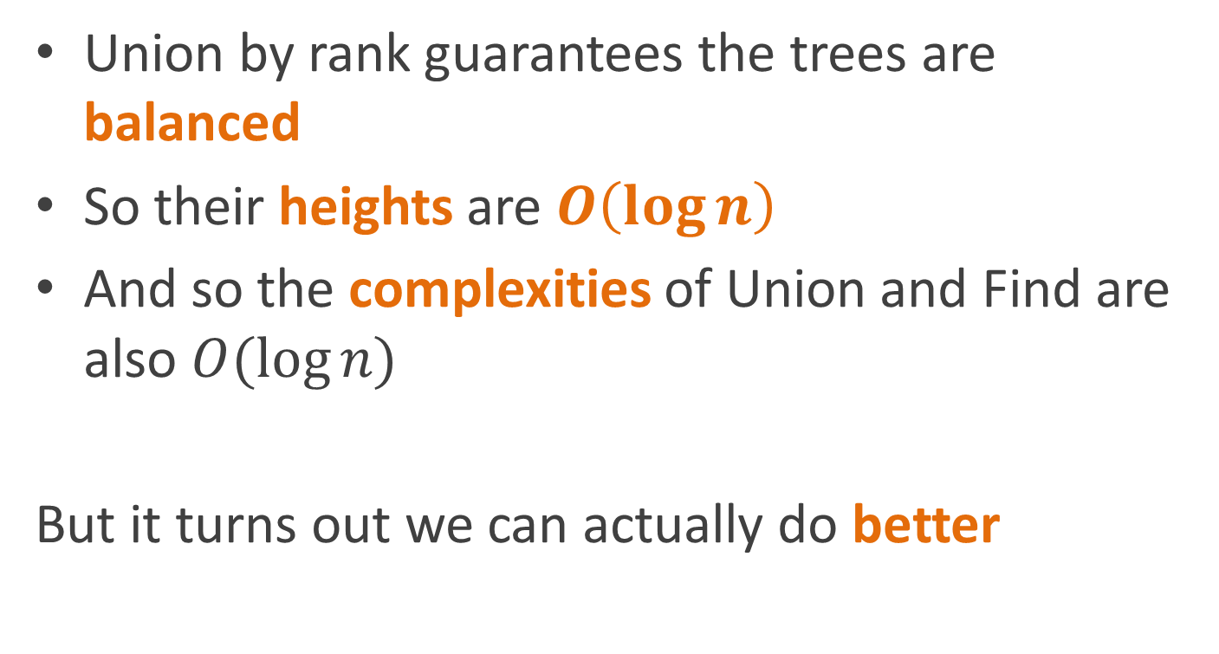
Complexity
Union by rank guarantees the trees are balanced
So their heights are $O\left(\log{n}\right)$
And so the complexities of Union and Find are also $O(\log{n})$
But it turns out we can actually do better

Slide 73
Saving redundant work
If we call Find on the same node twice
We run up the chain twice
Why not cache the original result?

Slide 74
Path compression
Just update the parent of the element
To point directly at the representative
And while you’re at it, update all the nodes on the path to the representative too!
Find(SetElement a) {
if (a.parent == null) return a;
a.parent = Find(a.parent);
return a.parent;
}

Slide 75

Complexity analysis
The bad news is that Find is still $O\left(\log{n}\right)$ in the worst case
So what’s the good news?

Slide 76
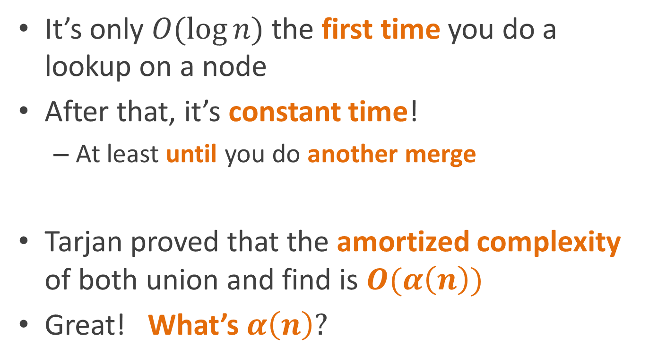
Amortized complexity analysis
It’s only $O(\log{n})$ the first time you do a lookup on a node
After that, it’s constant time!
At least until you do another merge
Tarjan proved that the amortized complexity of both union and find is $O(α\left(n\right))$
Great! What’s $α\left(n\right)?$

Slide 77

The Ackermann function
There’s this function called the Ackermann function:
$$A\left(m, n\right)= \left\{\begin{matrix}n+1, & \text{if} m=0 \\ A\left(m−1,1\right), & \text{if} m>0 \text{and} n=0 \\ A\left(m−1, A\left(m, n−1\right)\right), & \text{otherwise}\end{matrix}\right.$$

Slide 78
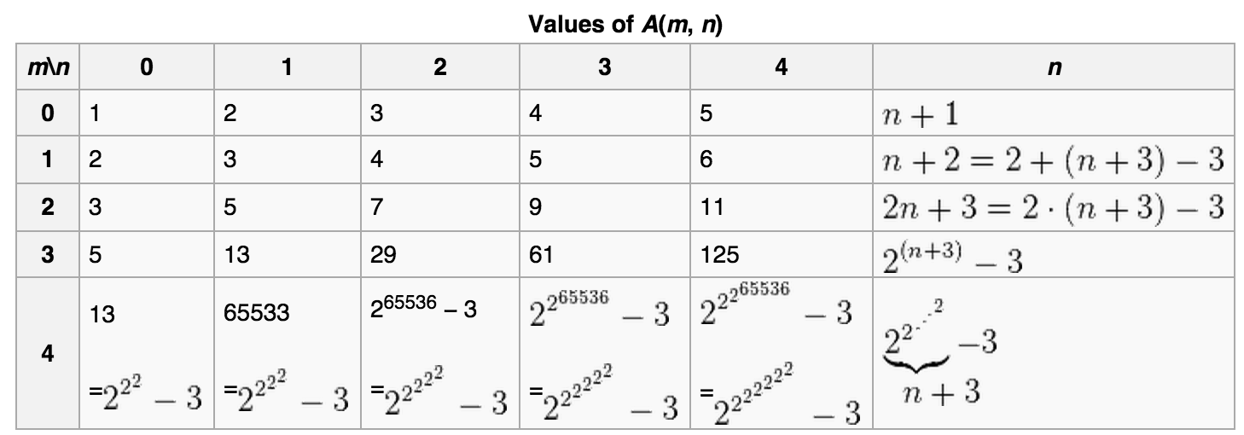
The Ackermann function
Here’s Wikipedia’s table of values for Ackermann’s function:
It grows really really fast.

Slide 79

The inverse Ackermann function
$α(n)$ is the inverse of $A(n,n)$
It grows really really slowly

Slide 80

The inverse Ackermann function
It grows comically slowly
$α\left(\text{the} \text{number} \text{of} \text{subatomic} \text{particles} \text{in} \text{the} \text{universe}\right)<4$
Estimated number of subatomic particles $≅{10}^{80}≅2^{265}$

Slide 81
The inverse Ackermann function
Did I mention it grows slowly?

Slide 82
The inverse Ackermann function
So slowly that it might as well be constant

Slide 83

Amortized complexity analysis
Tarjan proved that the amortized complexity of both union and find is $O(α\left(n\right))$
So for all practical purposes, it’s $O(1)$
That’s pretty cool

Slide 84
Incremental connected components
Add parent and rank fields to each node
For each edge (u,v) Union(u, v)
To test whether two nodes are connected check Find(u) == Find(v)
1
4
2
3
8
9
11
5
12
6
7

Slide 85


Amortized complexity
For each edge (u,v) Union(u, v)
To test whether two nodes are connected check Find(u) == Find(v)
1
$$O(α\left(V\right)E)≅O(E)$$
4
2
3
8
$$O(α\left(V\right))≅O(1)$$
9
11
5
12
6
7

Slide 86
Amortized complexity
For each edge (u,v) Union(u, v)
To test whether two nodes are connected check Find(u) == Find(v)
So we can compute connected component incrementally and still do it in linear time
1
$$O(α\left(V\right)E)≅O(E)$$
4
2
3
8
$$O(α\left(V\right))≅O(1)$$
9
11
5
12
6
7

Slide 87
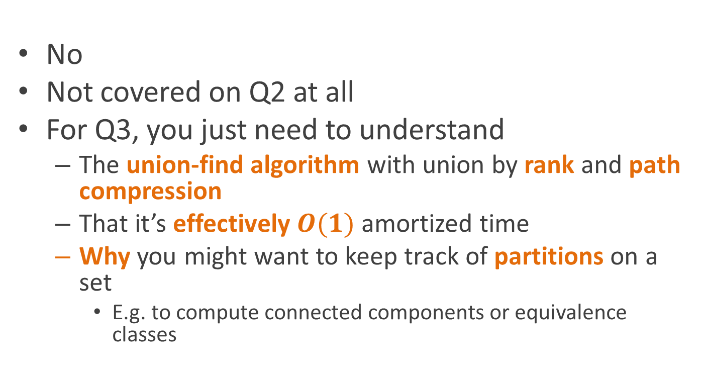
Oh crap! I don’t understand the Ackermann function at all! Do I need to know this for the quiz??!?!?
No
Not covered on Q2 at all
For Q3, you just need to understand
The union-find algorithm with union by rank and path compression
That it’s effectively $O(1)$ amortized time
Why you might want to keep track of partitions on a set
E.g. to compute connected components or equivalence classes

Slide 88
Reading
Read Chapter 21, sections 1-3

